Slide 1
Chapter 5: Dynamic Analysis-Test Design Techniques
Software Testing
Experience Based Testing & It’s Techniques

Slide 2
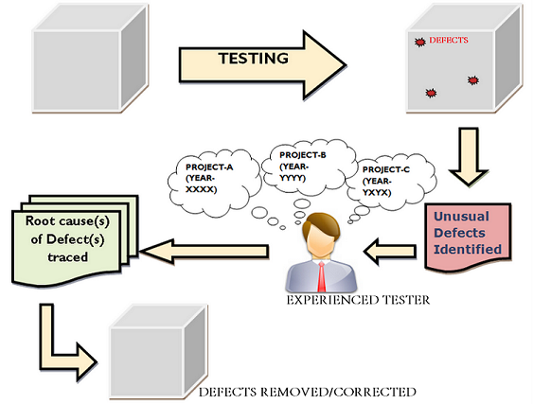
Experience Based Testing

Slide 3
Experience Based Testing
Besides the systematic approaches, intuitive determination of test cases
should be performed.
People’s knowledge, skills and background are of prime importance to the
test conditions and test cases.
Tester verifies and validates the software product quality
Proper strategy and documentation plan along with the gained experience
If used wisely may yield large success to the testers

Slide 4
When experience based testing is required?
Non-availability of requirements and specifications.
Limited Knowledge of the Software product.
Inadequate specification
Restricted amount of time, to perform testing.

Slide 5
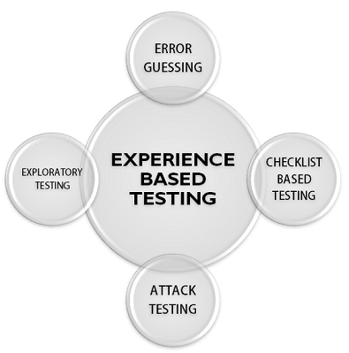
Experience Based Testing Techniques

Slide 6
Error Guessing
Technique of guessing and detecting the potential defects
Tester identify the vulnerable areas of the software product
This technique may be considered as a risk analysis method.
Tester assigns each area with low-risk, medium-risk and high-risk
defect areas

Slide 7
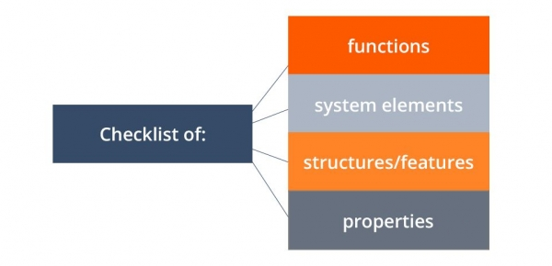
Checklist Based Testing
Based on the pre-planned “to-do” list of tasks called a checklist
Experienced tester based on his past experience prepares the checklist
Checklist reminds the tester of what to be tested
Checklist prepared by a tester is not the static and the final list
Ensures the complete test coverage in this testing.
Commonly used testing checklists are:

Slide 8
Exploratory Testing
It is used when basis for test design, are of low quality, are obsolete, or do not exist at all.
Approach is the test activities in exploratory testing are executed nearly in parallel.
Tester plans and designs what to be tested next while execution of the software.
It is hands on approach in which testers are involved in minimum planning and maximum test execution
Test charter for certain elements of program is created. (tasks or functions). While executing test charter these questions arise
- Why? (What is the goal of the test run?)
- What? (What is to be tested?)
- How? (Which testing method should be used?)
- What?( What kind of problems should be found?)
Key aspect of exploratory testing is learning.
- Software
- Uses
- Strengths
- Weaknesses
Example : shopping website

Slide 9
Attack Testing
Fault attack
Direct focused evaluation by attempt to force specific failures to occur
Principle of attack is based on interaction between software and its environment, including UI, OS with kernel, APIs and file systems.
Interactions are based on data exchanges, and misalignment in those can be the cause of a failure.
Software attacks (sometimes called fault attacks) are focused on trying to induce a specific type of failure.
The faults are injected into the software. Two types of injections:
Compile time injection
- source code is altered to inject simulated faults e.g changing b = b + 1 to b = b – 1
Runtime time injection
- software is triggered to inject the fault into the running software.

Slide 10
Choosing a Test Technique
Which technique is best?
Choice test techniques to use depends on a number of internal and external factors
Internal Factors:
Models used
Tester knowledge and experience
Likely defects
Test objective
Documentation
Life cycle model
Notes:
Models Used: This refers to the software development models adopted by the organization, such as Agile, Waterfall, or DevOps. Different testing techniques may align better with certain models. For example, exploratory testing might be more suitable for Agile projects due to its iterative nature, while structured testing might fit better with Waterfall projects.
Tester Knowledge and Experience: The proficiency of the testing team plays a crucial role in selecting the appropriate technique. Complex techniques like boundary value analysis or pairwise testing require skilled testers who understand the intricacies of software behavior and potential vulnerabilities. For less experienced testers, simpler techniques like equivalence partitioning might be more suitable.
Likely Defects: Understanding the common types of defects expected in the software can guide the choice of testing technique. For instance, if the application is prone to boundary-related issues, techniques focusing on boundary conditions would be prioritized.
Test Objective: The specific goals of the testing phase influence the technique selection. If the primary aim is to identify as many defects as possible in a short time, techniques like exploratory testing or error guessing might be favored. Conversely, if the focus is on verifying compliance with specific requirements, techniques like requirements-based testing or decision tables could be more appropriate.
Documentation: The availability and comprehensiveness of project documentation impact the testing process. Techniques such as requirements-based testing rely heavily on detailed documentation to derive test cases and expected results. In contrast, exploratory testing may be more flexible in scenarios where documentation is scarce or evolving.
Life Cycle Model: The stage of the software development life cycle (SDLC) also influence technique selection. Early stages might prioritize techniques like static testing, where code and documents are reviewed for defects before execution, while later stages may focus more on dynamic testing techniques like system testing or acceptance testing to validate the software against user requirements.

Slide 11
Choosing a Test Technique
External Factors:
Risk
Customer I contractual requirements
Type of system
Regulatory requirements
Time and budget

